Slide 1
SWIMMING
UP
WATERFALLS
Christine Durham
OAM, PhD, Dr of SocSc honoris causa RMIT
BIM Conference
November 4th 2020

Slide 2
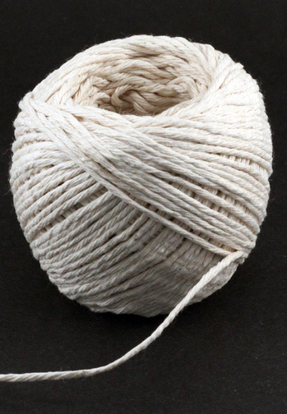
Only here because of a bit of string

Slide 3
My River of Life had been a wonderful journey with just a few mini waterfalls (challenges)

Slide 4
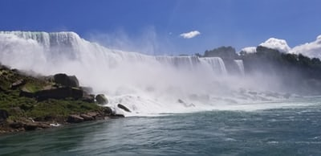
Brain Injury - no memory
Couldn’t walk, talk or think ‘properly’
Paralyzed left side
No balance - double vision
Difficulty with words & numbers

Slide 5
My damaged brain & body
was obvious but not my
damaged, spirit,
hope and confidence

Slide 6
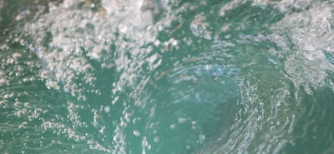
Be your own best friend
I was sucked into a whirlpool:
I hated myself – lost & trapped,
helpless, hopeless & fragile,
Isolated - felt I had lost everything
© Talk About Change 2020

Slide 7
Another whirlpool was
The criminal court case – seeing the man who had done this to me – my hatred was using up all of my energy
© Talk About Change 2020

Slide 8
In this whirlpool: I had no control of my body or my words
Frightening doctors’ visits for the civil court case
© Talk About Change 2020

Slide 9
I had no control as I didn’t understand brain injury – I expected the ‘experts’ to ‘fix’ me
I had to acknowledge my difficulties and find ways to ‘fix my life’ myself
© Talk About Change 2020

Slide 10
It seemed hopeless. I thought I could never be saved from the deep water
I was told I’d improve for 2 years then I would plateau out, so I lost all hope of ever recapturing my life.
© Talk About Change 2020

Slide 11
I was drowning, disempowered by all the tests
Ashamed I was so dumb and stupid
I lost all confidence
I felt unlovely and unlovable
I was isolated on our hillside
© Talk About Change 2020

Slide 12
I desperately needed a ‘lifesaver’ to help me understand the challenges
Test results need to be explained & what can be done to improve
‘Mild ABI’, plateauing, the 2-5 year rule, “You will never...” should be banned
© Talk About Change 2020

Slide 13
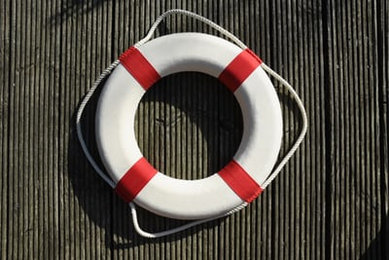
My ‘lifesavers’ were my family, my son Rob, and Maureen Malloy who explained the tests to me.
© Talk About Change 2020

Slide 14
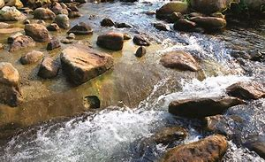
Swimming upstream
to a ‘new normal’
reminds me of fish ladders.
‘Steps’ (fish ladders) in France
in the 17th century to allow fish
to swim up waterfalls
© Talk About Change 2020

Slide 15
Fish could swim up a small slope,
have a rest, tackle
the next effort to swim up another
small slope
© Talk About Change 2020

Slide 16
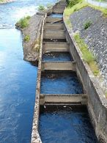
Some of my ladders were:
Realising hating others was a
luxury I couldn’t afford
Realising I was jealous of everyone
because they were normal, I was not
© Talk About Change 2020

Slide 17
Learning to stop cursing myself
calling myself “you bumbling idiot”
To stop being my own worst enemy and become my own best friend

Slide 18
Learning about faulty thinking:
Catastrophising, minimising,
‘should’, ‘all-or-nothing’, overgeneralisation, jumping to conclusions, mind reading..
Often my FEAR was False ‘Evidence’ Appearing Real
© Talk About Change 2020

Slide 19
I found comfort in nature, feeding the birds and our dog
Achieving small things – unpacking the dishwasher, making soup or a cake gradually my small achievements gave me more confidence

Slide 20
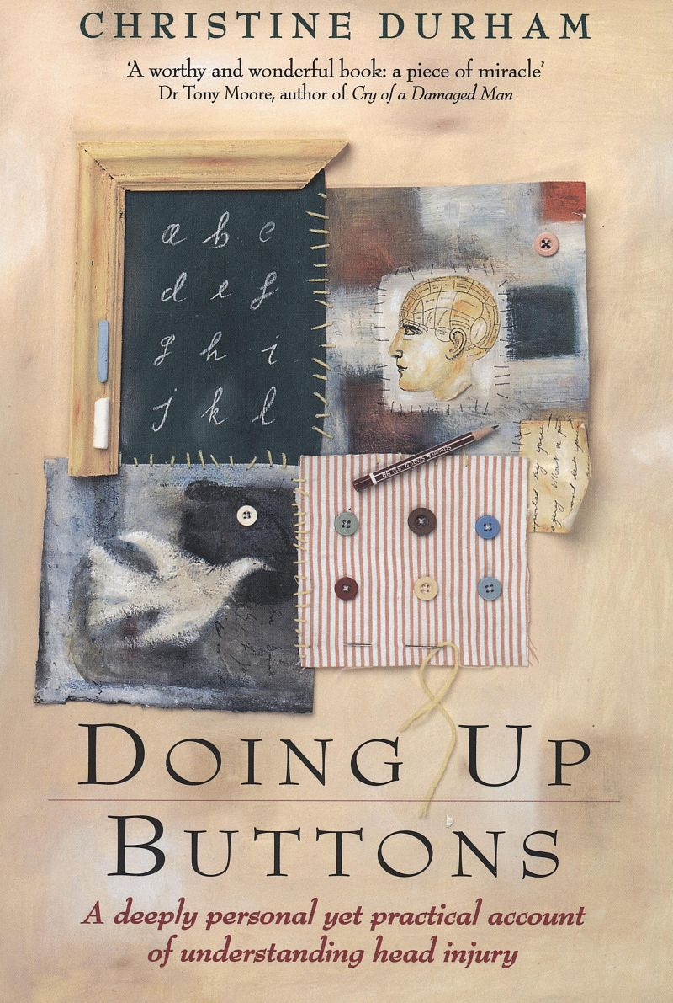
I wrote ‘Doing Up Buttons’ (Penguin Australia)
I didn’t want anyone to ever feel as lost and scared and bewildered as I was

Slide 21
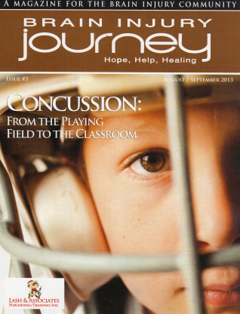
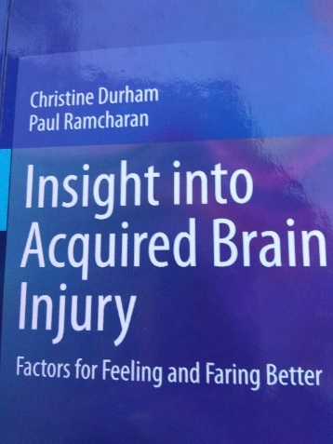
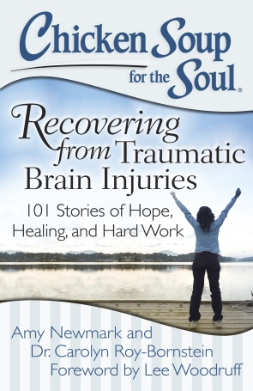
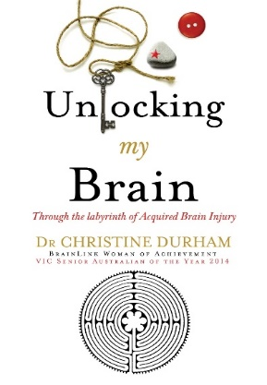
Trying to be a ‘lifesaver’
I’ve written books and articles
to help people get out of deep water (understand)
Henry Stewart Talks:
The Biomedical & Life Sciences Collection UK
Honours:
Prior Victorian Senior Australian of the Year, BrainLink Woman of Achievement, Ambassador Shine a Light on Road Safety, Australia Day Ambassador

Slide 22
As a ‘lifesaver’ I’ve been busy
with talks to help people get
out of their deep water
Perth’s Women with Brain Injury Forum (WA); Flinders University (SA); Charles Sturt University, Albury-Wodonga (Vic); North Coast Head Injury Association (NSW); Brain Box Qld); Headway (Melbourne, Bendigo, South Gippsland); Headway Victoria Writers Forum; Sydney Brain Injury Rehabilitation Team Randwick (NSW); HeadEast Pagewood (NSW); Barwon Health, Geelong, (Vic); Head West (WA); Shepparton Advocacy Day, Regional Information and Advocacy Council Inc.; Australian Occupational Therapy Victorian State Conference; South West Brain Injury Rehabilitation Service; Transport Accident Commission, (Vic); Sydney Children’s Hospital (NSW); Private Healthcare Providers; Victorian Neuro Trauma Initiative, Seminar Series; Headway, Oxford. (UK); Western Suburbs Acquired Brain Injury Support Group Footscray; City of Stonnington Aged and Diversity Staff Social Support quarterly General meeting; Guide Dogs Association; Bendigo TAFE Disability Liaison Officers Conference, Bendigo; Acquired Brain Injury Road Trauma Support, Shepparton & Hawthorn; Brain Link Support Group; Western Suburbs Acquired Brain Injury Support Group; Bear In Mind writer’s group; Brain Injury Matters; Mobile Intensive Care Ambulance East and West Paramedics team meeting; Victorian Rehabilitation Centre, Glen Waverley; Cedar Court, Hawthorn; Special Schools Conference; Mercy Health and Aged Care Inc.; Commonwealth Rehabilitation Service Conference; Disability Employment Service Conference; Regional Information and Advocacy Council Inc. (Hume Area) Benalla, Broadford; Headway Conference; South Gippsland Focusing On Care & Support Group; Spastic Society. Coffs Harbour NSW; Brain Injury Association of Canada; Australian Institute of Management Conference, Melbourne; Perri Cutten, Richmond, (Vic); Shepparton Goulburn Leadership Dinner; The Alexandra Club, Melbourne; SWAP (Sales People With a Purpose) Conference, Yarra Valley; Australian Funeral Directors Conference Canberra (ACT); Nursing Mother’s Hotmilk Conference; Banyule City Council; Fairley Leadership Programme; National Australia Bank Conference, Werribee; Nelson Alexander (real estate) Breakfast, Melbourne; Head East (NSW); Caroline Chisholm Society...

Slide 23
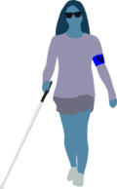
At the rehabilitation hospital
we all walk funny,
talk funny
and think funny
but
it’s not funny.

Slide 24
It’s not funny that we can’t see properly and we can’t understand
© Talk About Change 2020

Slide 25
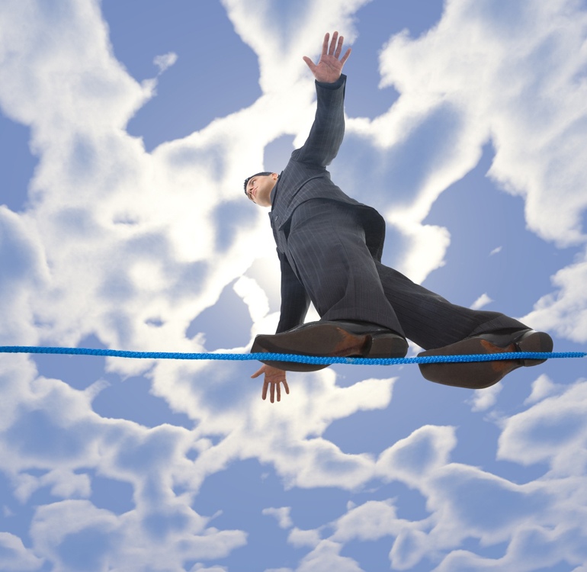
It’s not funny that life is like walking a tight-rope
© Talk About Change 2020

Slide 26
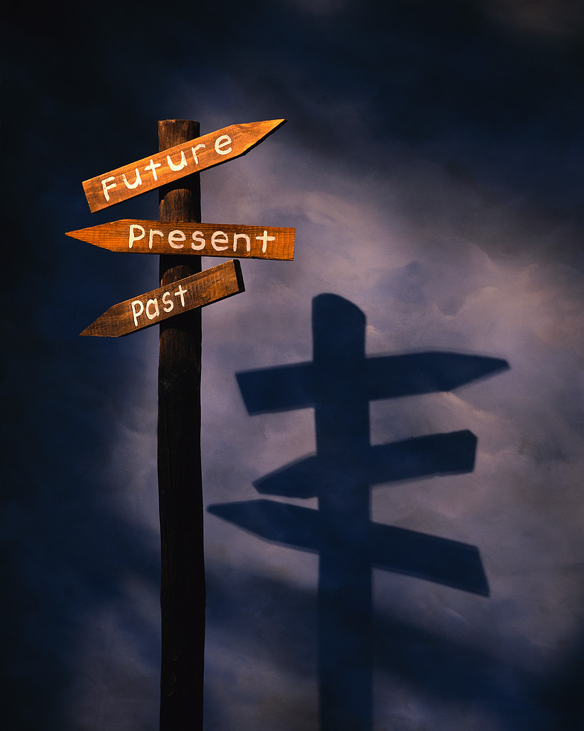
It’s not funny that we lose our sense of direction & lose our direction in life – and have to find a new direction
© Talk About Change 2020

Slide 27
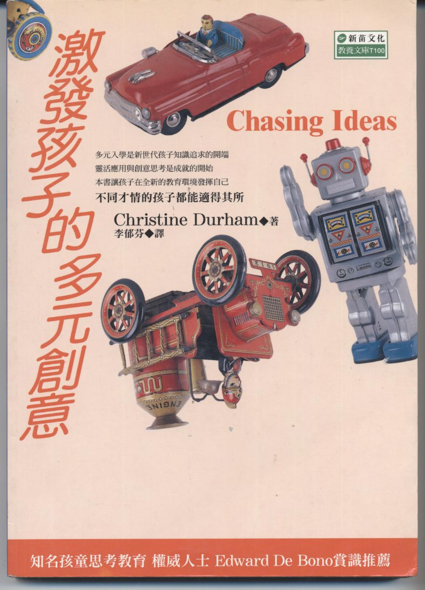
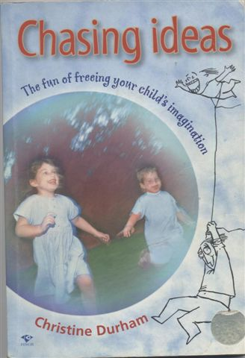
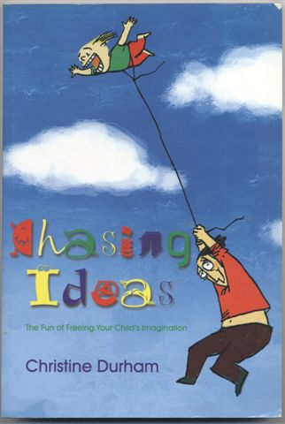
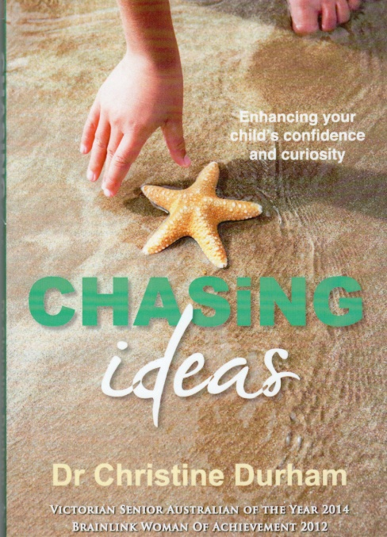
My new direction was taking 4,000 Philosophy-Thinking Workshops – Handy Thinking helps us

Slide 28
My book and talks seemed to be helping people understand
How could I help professionals gain greater insight into the lived experience of brain injury?
I needed to do a PhD!

Slide 29
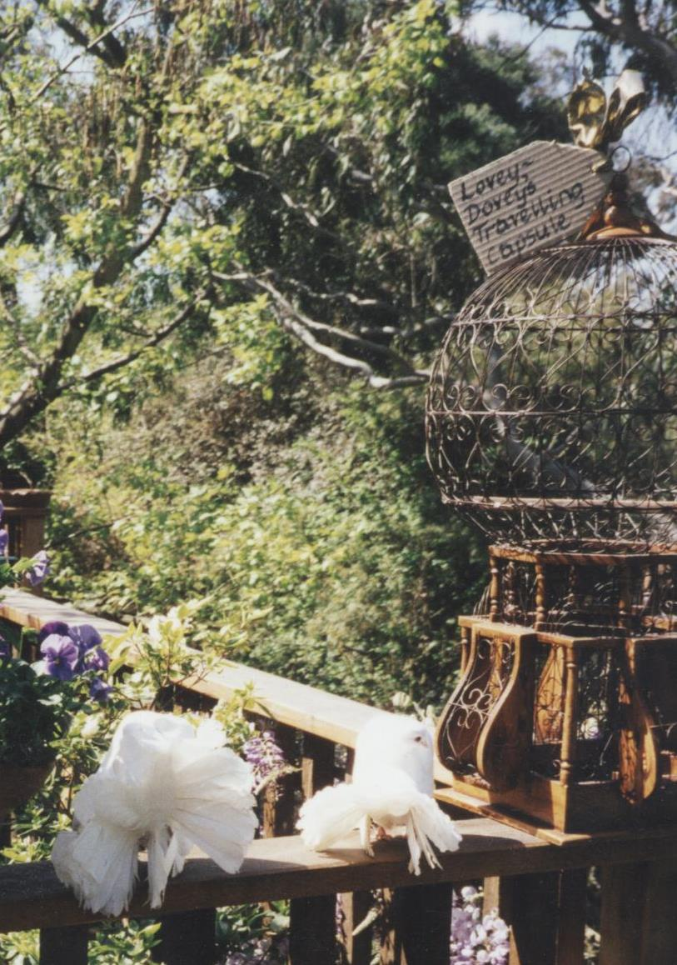
How could I talk to people with
brain injury without making them feel bad?
Here are my two fantail doves Lovey Dovey & Cloud
Brain injury is a challenge! It’s like being locked in a cage then the key is thrown away

Slide 30
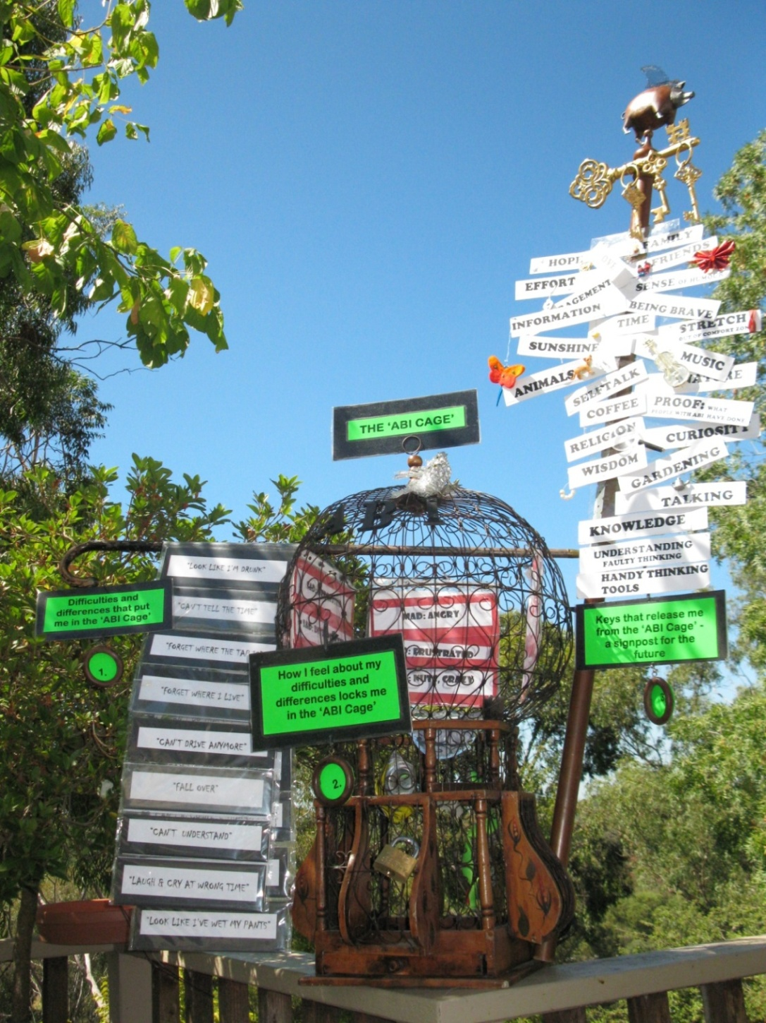
Keys to The ABI Cage
© Talk About Change 2020

Slide 31
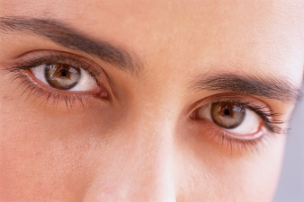
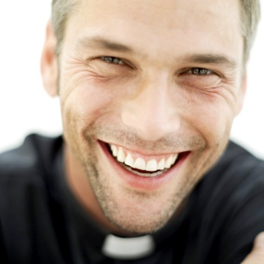
To use their eyes
to see things differently

Slide 32
To use their heart
to reflect on how they
felt about things

Slide 33
To use their ‘funny bone’
and their wonderful sense
of humour

Slide 34
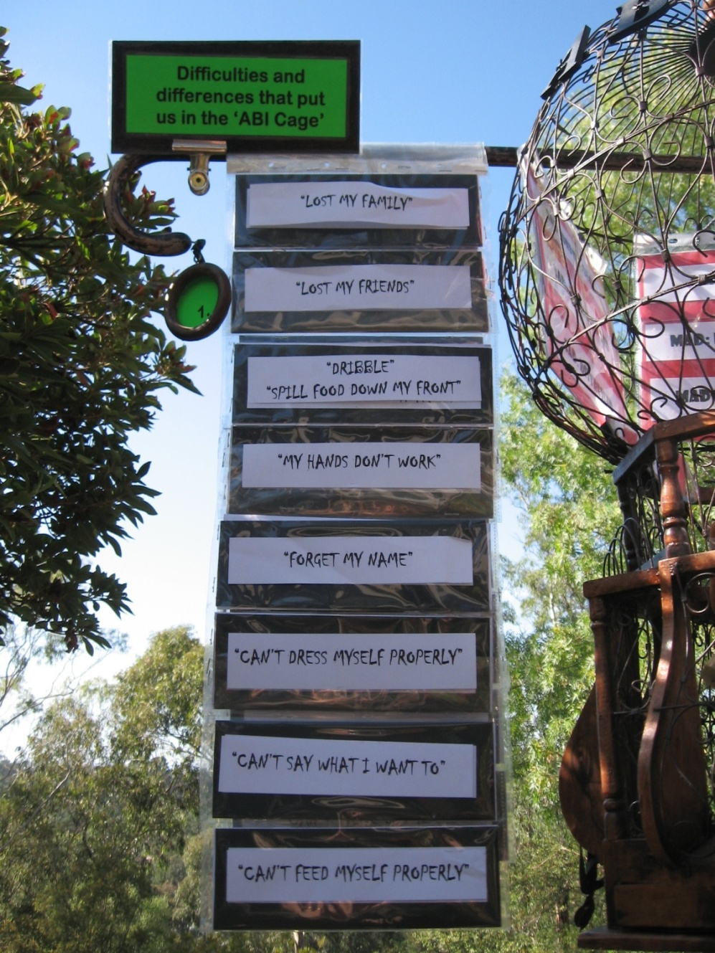
1.
Our differences and difficulties
can PUT us in the Cage
© Talk About Change 2020

Slide 35
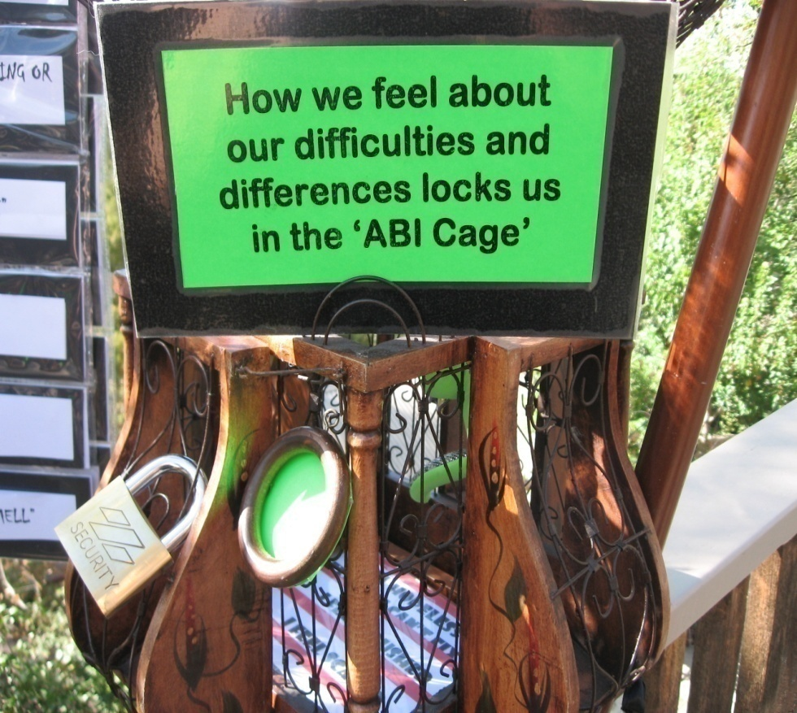
2. How we feel about our Differences
and Difficulties can LOCK us in the Cage
© Talk About Change 2020

Slide 36
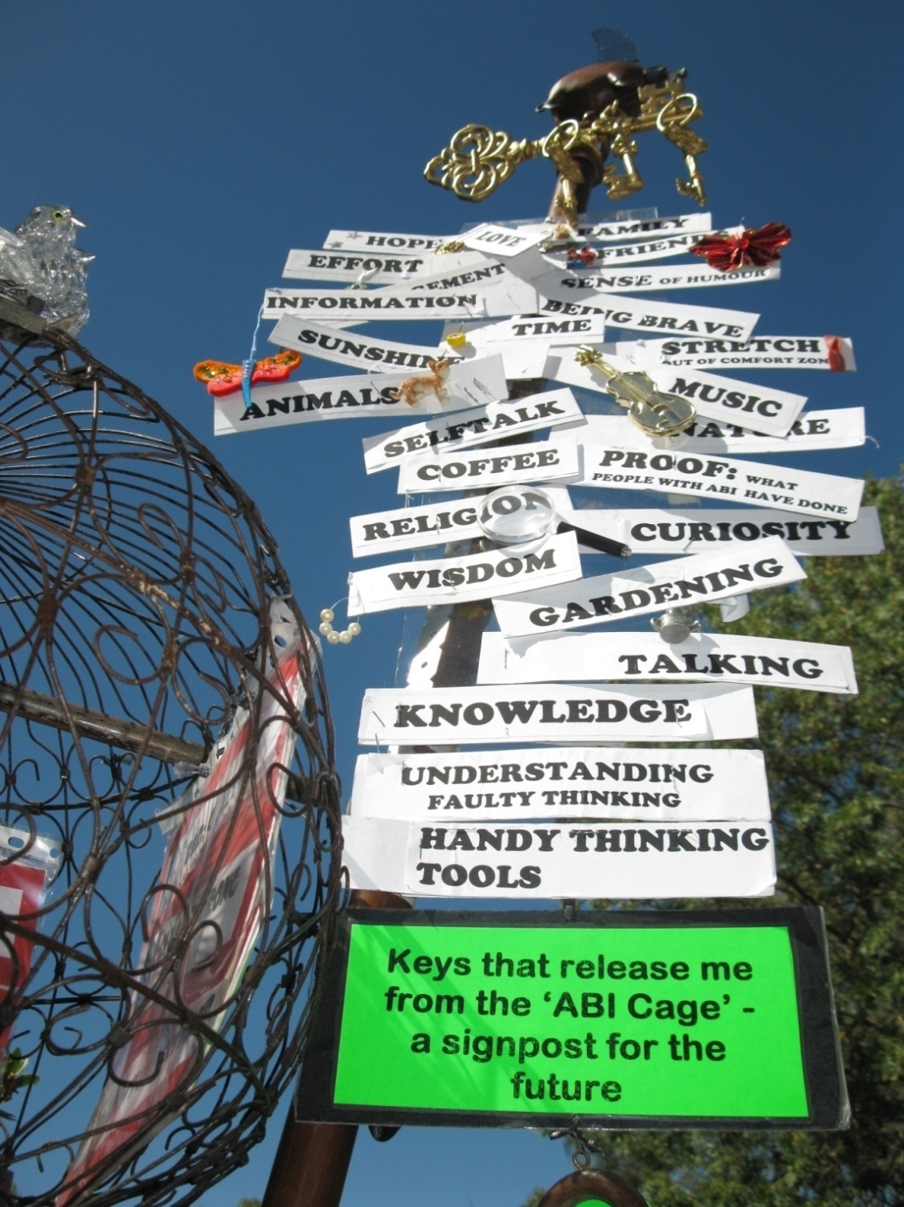
3. There are many keys that can
RELEASE us from the Cage

Slide 37
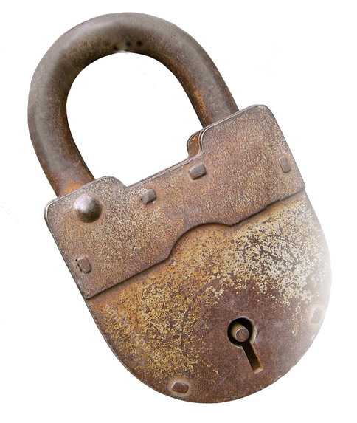
People can feel:
Afraid, ashamed, isolated
Sad disappointed, distressed & depressed
Mad angry, frustrated & crazy
Bad guilty, stupid & dumb

Slide 38
‘Rehab’one of the 60 ‘talk-about’ cards - more than half the 36 participants with ABI felt it didn’t suit them
loss of choice,
disempowered, tests
loss of hope, (2 year rule)
professionals didn’t know what it was like
not a ‘textbook case’ but treated like one

Slide 39
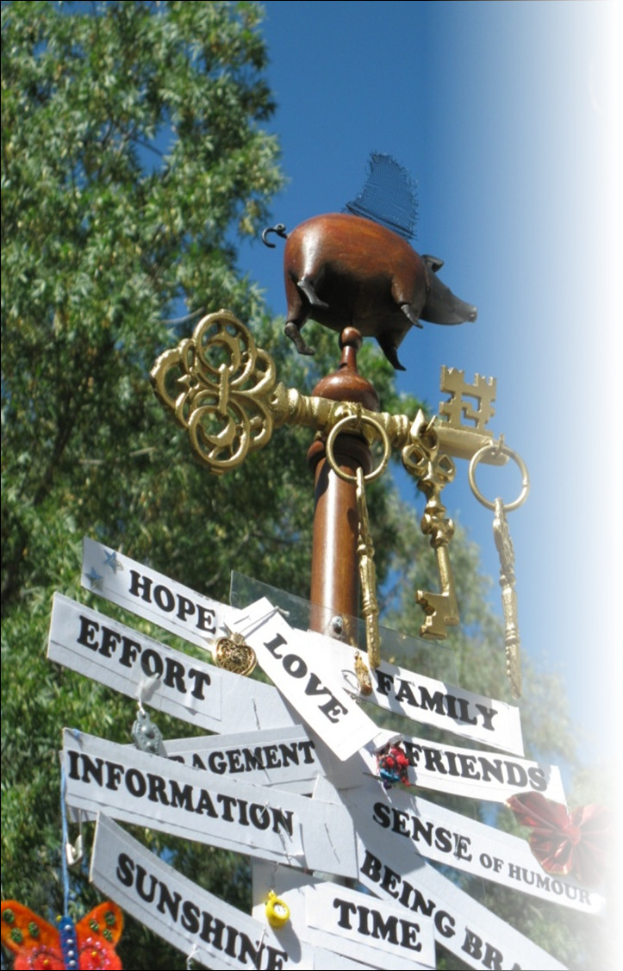
Appreciate being alive Aware of their strengths & weaknesses Feel wise

Slide 40
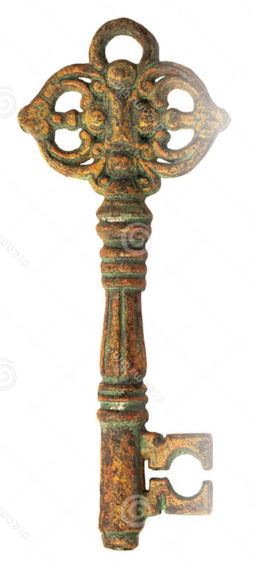
‘Keys’ to Life’s Challenges
Never, never, never, never, never, never, never, never, never, never, never, never, never, never, never,
EVER give up

Slide 41
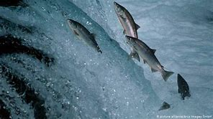
1. Hope
Determination
Ignoring the problem
Wishful Thinking
© Talk About Change 2020

Slide 42
2. Love
Family & friends
Empathy & understanding
Encouragement
Things we love to do
Helping others
© Talk About Change 2020

Slide 43
3. Learning to face the facts
Understanding
Accepting
Resilience
Having a positive attitude
Having a sense of humour
© Talk About Change 2020

Slide 44
4. Making progress: brain injury is not all bad
Doing normal things
Returning to work/study/volunteering
Being able to get out & about
Achieving hard things
The ‘survivor’s high’
© Talk About Change 2020

Slide 45
The plasticity of the human brain PLUS the plasticity of the human spirit BOOST the plasticity of human potential
© Talk About Change 2020

Slide 46
A river cuts through rock
not because of its power
but because of its persistence
© Talk About Change 2020

Slide 47
You drown, not by falling into deep water, but by not finding ways to get to the surface, to take a breath, to find ways to go with the flow, till you finder a safe place
© Talk About Change 2020

Slide 48
I didn’t drown because I found ways to learn to help myself struggle to the surface
to take a breath, then to find ways to go with the flow till I found a safe place
© Talk About Change 2020

Slide 49
I’ve learnt that triumph
= try + umph
HOPE stands for Help Other Possibilities Emerge
© Talk About Change 2020

Slide 50
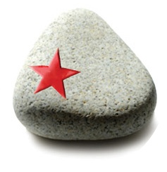
Peace of Hope
‘Piece of Hope’
‘Hope Stone’
Something hard to remind us that we can find ways to tackle hard issues and reach for the stars

